Slide 1
SEP
User Research
(Homepage – Search prototype testing)
Nov 2020
Anubhav Mittal

Slide 2
Who we tested with
10 Online un-moderated test sessions, with Userzoom panel, for usability testing
Male – 5 / Female – 5
Location: Scotland

Slide 3
What we were trying to find out
We explored the following things:
Users likes and dislikes about the homepage of findbusinesssupport.gov.scot website
If they felt there was anything missing
Feedback around an alternate design of the homepage containing search box and quick filters and users likes and dislikes of the new designs
Design 1 (with “search box” deature) - https://b8ro2r.axshare.com/#id=c8zyyg&p=homepage_with_search&c=1
Design 2 (with “quick filter by popular topics” feature) - https://b8ro2r.axshare.com/#id=jbuy7b&p=homepage_with_popular_topics&c=1
Scenario used to test the above designs: Your business has had to reduce your opening hours and limit services because of local lock-down measures. Can you find government funding to compensate you for the loss of revenue?

Slide 4
FBS homepage – likes and dislikes
When we asked the users about their likes and dislikes upon looking at the homepage following things were mentioned:
Top 3 likes per user Top 3 dislikes per user
Top 1 | Top 2 | Top 3
Browse support
the search box | the covid updates
Functional | Easy to use | Well laid out
Coronavirus updates | Signup email
that it was Scotland specific | it referred to Brexit as well as Covid-19 | I liked the browse support
eye catching | modern | easy to use (simple headings)
focused | summarized | clean design
it is simple | the design is clean | Easy navigation
Layout | Simple and easy to understand | Attractive
Gets to the point | Looks good | Easy to navigate
Top 1 | Top 2 | Top 3
too broad
Background image | header categories are too simple. | not enough guidance on how the site operates
the pic was of engineers which may make visitors think this is aimed at engineering and construction | Brexit should have been mentioned on the top menu as it’s going to be just as crushing on business as the pandemic
repetitive | old fashioned design | can’t think of more
it’s far too simplistic eg old fashioned | it looks cumbersome to navigate | needs more on-screen navigation tools

Slide 5
FBS homepage – anything missing
Things users mentioned when asked if there was anything missing from the homepage:
Top 1 | Top 2 | Top 3
add check your area for the tier system | Phone number
The homepage looks like a construction information page rather than a general business page
Lack of Advanced filter options | Lack of a search bar | lack of guide to help distinguish
Brexit should be on the top menu | email updates should be further up the page nearer the top | about us would be better at the top menu too
Yes, not enough navigation menus | needs to be more user friendly | not geared to first time users

Slide 6
Homepage design 1– likes and dislikes
When we asked the users about their likes and dislikes upon looking at Design 1 -https://b8ro2r.axshare.com/#id=c8zyyg&p=homepage_with_search&c=1 following things were mentioned:
Top 3 likes per user Top 3 dislikes per user
Top 1 | Top 2 | Top 3
the amount of information
Layout | Functional | Easy to use
The search bar | The filter options | Clearly stating which industries are involved in the title
it was very clear and not cluttered | there were several corona results
easy to use | good to have search function
search box
design is clean
Nice layout | Easy enough to navigate | Attractive
Looks good | Easy to filter
Top 1 | Top 2 | Top 3
Support are too broad, way too many results
the background photo
Same boring background image | A little bit of filter options | The header remains limited in options
too many results that weren’t related to my query
no postcode search for relevant lockdowns
repetitive | old fashioned design
too simple | search bar is too big
Not enough options
Didn’t get desired results at first

Slide 7
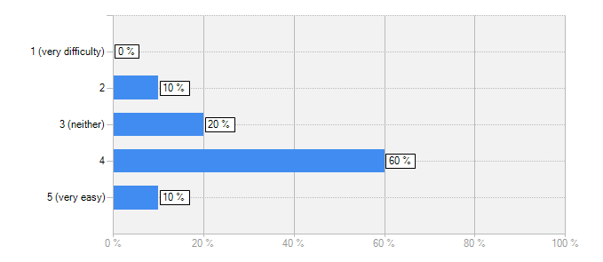
Homepage design 1
How easy or difficult was it to use Design 1 in order to get relevant scenario results?
Answer | Count | Percent
1 (very difficulty) | 0 | 0%
2 | 1 | 10%
3 (neither) | 2 | 20%
4 | 6 | 60%
5 (very easy) | 1 | 10%
answered question | 10
was not the first result of my search, had to scroll down a lot
i think it wouldn’t be too difficult as the page has a lot of information
It was easy to use design 1 to get the relevant scenario but I also had to use filters to find the result.
It was easy because I chose a general keyword and isolated my needs with filter options.
It was easy to use but less relevant results to my query came up. This included one asking whether you had a viable business idea.
the browse funding seemed to work well and it was good that it is divided into job sectors
the search box and the filter worked really well
it was ok. very generic design, not particularly user friendly. if you were a first-time user, you may be confused.
I could not click on the tab at the top right. It was okay but I felt it could have been clearer - there were so many results to choose from. Could it be broken down into smaller categories? Size of business/ location etc. I was worried I might click on the wrong one.
I thought I should’ve gotten a relevant result for what I originally searched, but searching a broader term got less results somehow

Slide 8
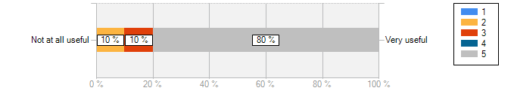
Homepage design 1
How useful is the "Search box" feature in this design 1:
1 | 2 | 3 | 4 | 5 | Total | Mean
0% (0) | 10% (1) | 10% (1) | 0% (0) | 80% (8) | 10 | 4.5
answered question |  |  |  |  | 10
I think the search box is very helpful as it can take you to exactly where you need to be
I was able to use the search box to arrive at the information I was looking for.
A big improvement, it adds to the efficiency.
Only downside was less relevant results before the relevant one I needed.
if you can’t find specific info in the browser section then using the search term is helpful in narrowing down the task
Sometimes you don’t know what you are exactly looking for or from where to start and having a search box helps with than
not very useful, not very user friendly, needs a lot of work to make it less obtrusive on the screen, make the search box smaller and give space to commonly searched information and provide links to those.
I should have used the search box, however, I thought the most relevant result would come up first just by clicking ’coronavirus’ and ’funding.’ You often get random results which are irrelevant when using search functions on websites like this, that’s why I chose not to.
It will probably be easier to find what you need by searching than looking in the specific areas

Slide 9
Homepage design 2– likes and dislikes
When we asked the users about their likes and dislikes upon looking at Design 2 -https://b8ro2r.axshare.com/#id=jbuy7b&p=homepage_with_popular_topics&c=1
following things were mentioned:
Top 3 likes per user Top 3 dislikes per user
Top1 | Top 2 | Top 3
quick filters
I liked this better | the Brexit information
Quick | Easy | Intuitive
The quick filter saves me time selecting. | The options on the main page are plentiful | And the Navigation having many filters is less stressful
different boxes for corona and Brexit
easy to see what is going on with different quick filters for brexit and covid | seems intuitive
the links to important information
Layout | Nice colours | Attractive
Looks good | Easy to filter
Top 1 | Top 2 | Top 3
Same boring background | I would like to have a search bar | Coronavirus and brexit are not the only things affecting businesses.
same irrelevant search results came up before one I needed
no area search for specific lockdown info
repetitive | old design
the search box is still way too big
Was no easier than design 1 to find results

Slide 10
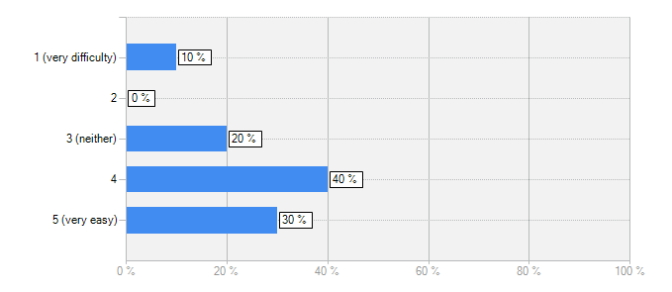
Homepage design 2
How easy or difficult was it to use Design 2 in order to get relevant scenario results?
Answer | Count | Percent
1 (very difficulty) | 1 | 10%
2 | 0 | 0%
3 (neither) | 2 | 20%
4 | 4 | 40%
5 (very easy) | 3 | 30%
answered question | 10
I think it was quite easy
Using the quick filter for popular topics makes the search quicker and easier.
Once I started to filter and search through the results, I could see the perfect result for me. But it is truly important to isolate the most appropriate result.
Good that you could click on Coronavirus or Brexit help. Good to know both are covered.
the quick filters are a great idea and is good that there is also a search function on the next page
I clicked on it, use the filter on the right of the page to filter more the results and I found it in less than a minute
The huge search box with little important information, this could be smaller, and still allow people to search and then put the important information or updates in another box next to the search box.
It wasn’t any different from the first scenario, only that it had one filter automatically selected

Slide 11
Homepage design 2
If there are any suggestions to improve this Design 2, then please list them below:(
Top 1 | Top 2 | Top 3
More quick filter options. | More filter options on the results page | A list of industries to choose from.
make the top results more relevant and less general
area/postcode search function to get straight to relevant funding for local lockdowns | mention of furlough even if it is not currently available
keep the search button | upgrade the design
make the search box smaller | include more dynamic links | include live updated information re covid 19 information
Improve search function | Explain the difference in results more clearly
Make filtering and search terms more effective

Slide 12
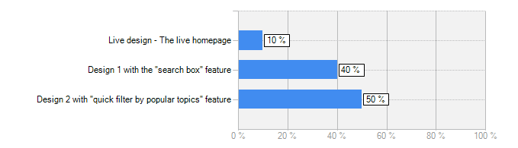
Homepage designs - which version?
Which of the three design did you prefer and felt would assist you to find relevant help on this website?
Below are some comments in support of Design 1:
I think it was more simple and easy to understand
Much easier to use.
Search bars are very effective, but they need quick filter options to make them fast and effective.
The search box was easy to use, but I found the other designs were fine too. I chose the search box because I am more used to using sites with this function.
And, below are some comments in support of Design 2:
Quick filter options give people the opportunity to quickly find the general information they need which will then allow them to search for other related information.
easy to use and good it has brexit and covid as topical filters
It is an attractive design and seems pretty easy to navigate.
Answer | Count | Percent
Live design - The live homepage | 1 | 10%
Design 1 with the "search box" feature | 4 | 40%
Design 2 with "quick filter by popular topics" feature | 5 | 50%
answered question | 10

Slide 13
Thank you!

